Slide 1
Fundamentals of Algorithms
Objective 5
“Data structures and efficiency”

Slide 2
Homework? Recap
How can we create a FOR loop in Python?

Slide 3
Data structures
Defines how the flow of data is controlled in relation to inputs, processes and outputs
Two main characteristics:
Either static (array) or dynamic (list)
Either mutable (array) or immutable (tuple)
Tasks generate a list, array and tuple and try to add values to these
We can have either 1-D or 2-D data structures
Columns in a dataframe
A Python dictionary, give example of usernames and passwords
To track the values in a data structure we can use trace tables to record results
Generate a trace table for the 5 times table of values from 1 to 10
Exercise 1: Battleships task

Slide 4
Algorithm efficiency
Many algorithms can be used to solve the same problem
Give examples from your own work/previous experience
https://www.bbc.co.uk/teach/class-clips-video/searching-algorithms/z662pg8

Slide 5
Linear search
Search through data from beginning to end to find what you are looking for
Pretty slow depending on the data size
FOR loop through a list of variables
Generate a list of names, including yours at a random location, and use a linear search to find your name and the position in the list (either the index or normal position is fine)
Exercise 2: Search a dictionary for a word using a linear search

Slide 6
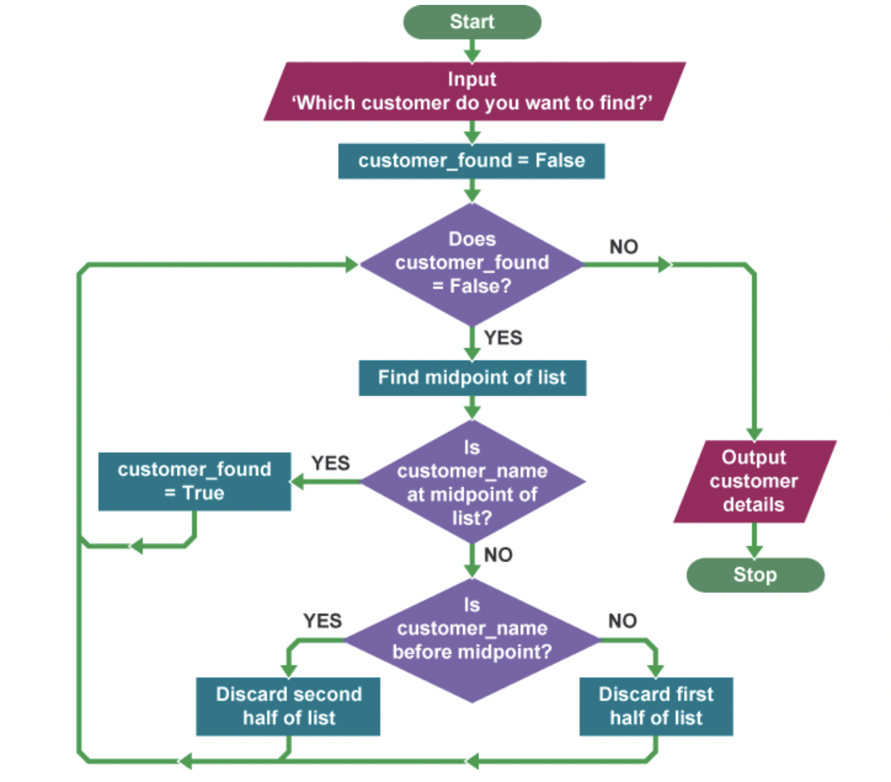
Binary search
Data has to be in order
Takes the midpoint of the data and selects a data subset that contains the target based on whether the algorithm has gone past or has not reached your target
Flowchart used for a list of names in alphabetical order
Exercise 3: Improve a dictionary search using the binary search method

Slide 7
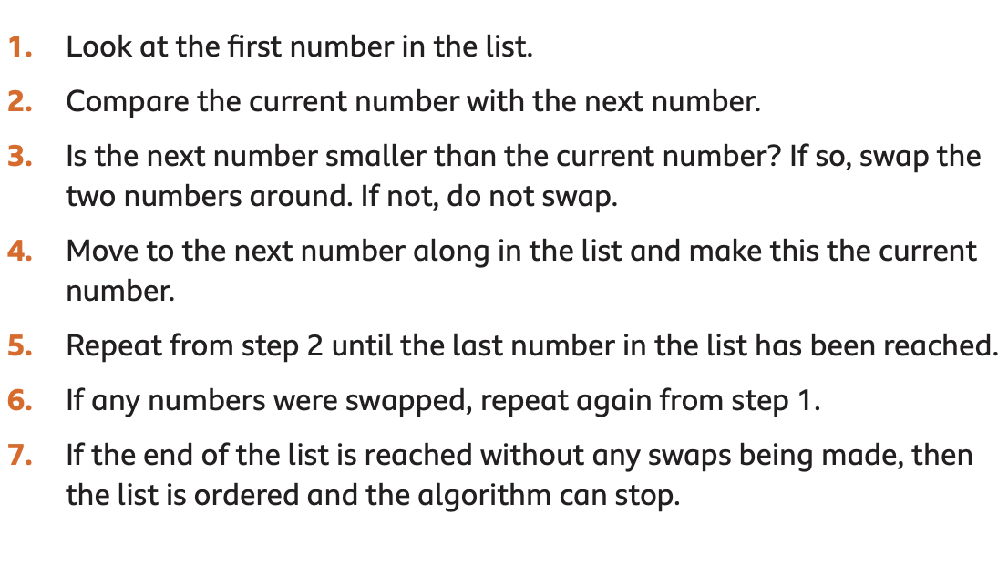
Bubble sort
Simplest sorting algorithm
Takes the first two values check if they are in order, if not swap. Select the next value and check if they are in the correct order
Exercise 4: Input a list of weights (grams) and order them using bubble sort

Slide 8
Merge sort
Puts values into groups, sorts each group separately and combines
This could be split into halves and each element, as pairs are sorted in order and combines them together
https://www.bbc.co.uk/bitesize/guides/zjdkw6f/revision/5

